Slide 1



AAC Football Database
By: Aaron Fye, Reid Richardson, Bryan May, and Zack Yarbrough

Slide 2
Our Database
Want to model the most recent 2016 American Athletic Conference football season
Easier way to view and select different teams inside the conference
Allows for comparison of coaches
Allows for easy comparison of stadiums
Rosters and coaches are easy to update

Slide 3
Referential Integrity
Our use of primary keys and foreign keys makes it simple to use natural joins in SQL
Allows for easy joining of tables based on logical connections between keys

Slide 4
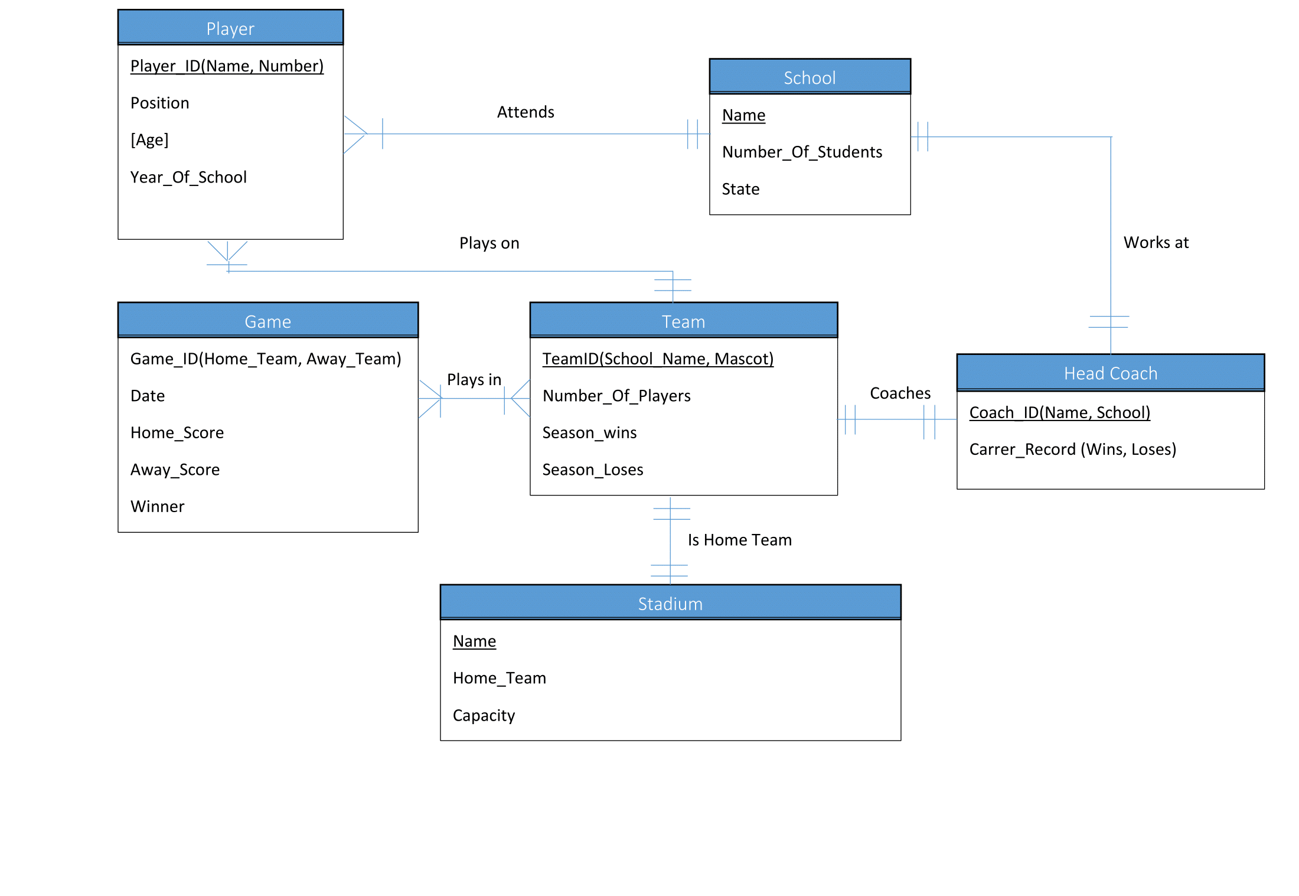
ER Diagram

Slide 5
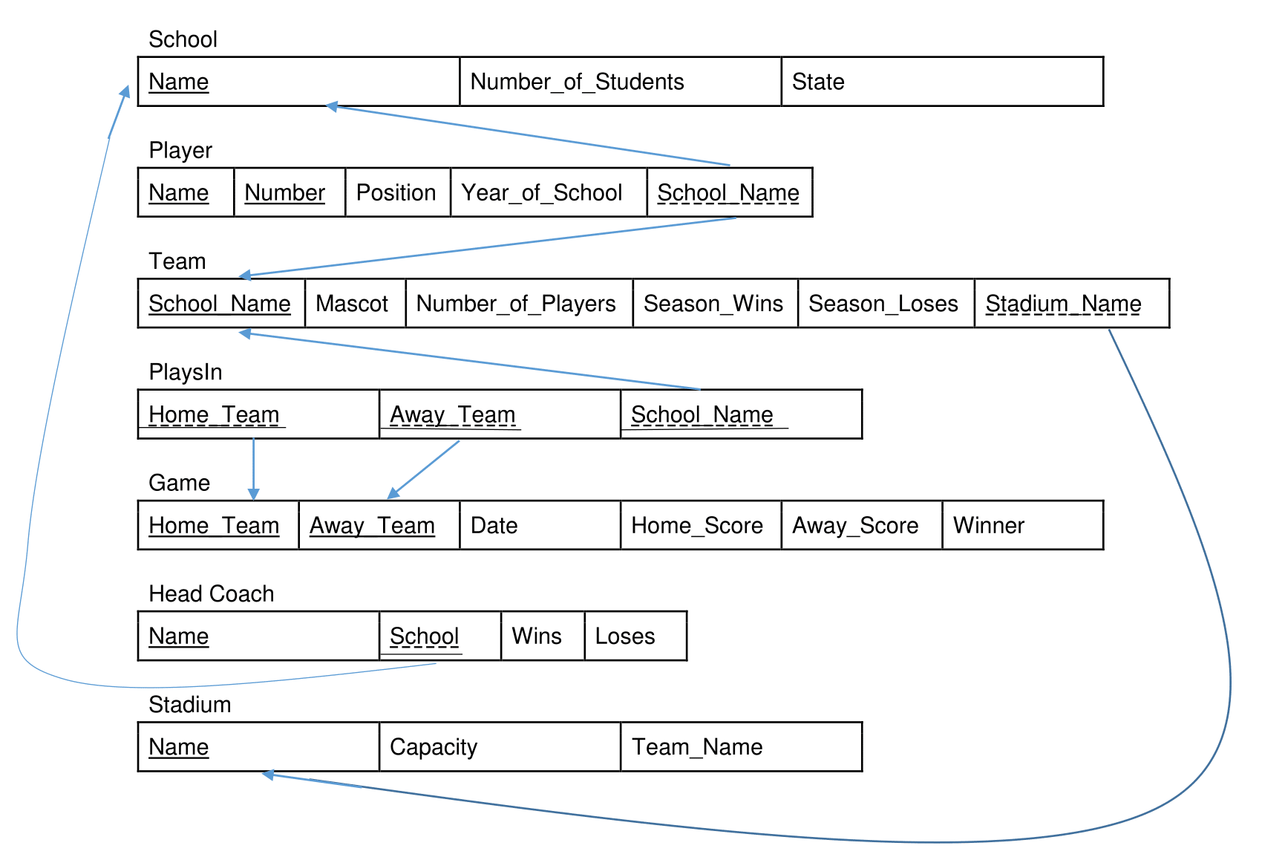
Relational Schemas

Slide 6
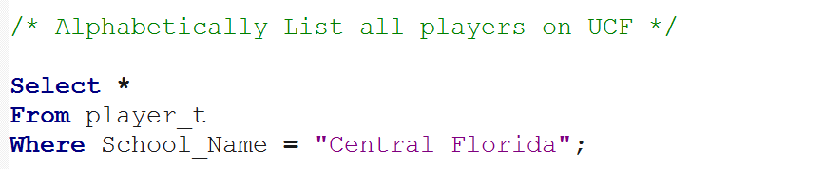
Queries Examples

Slide 7
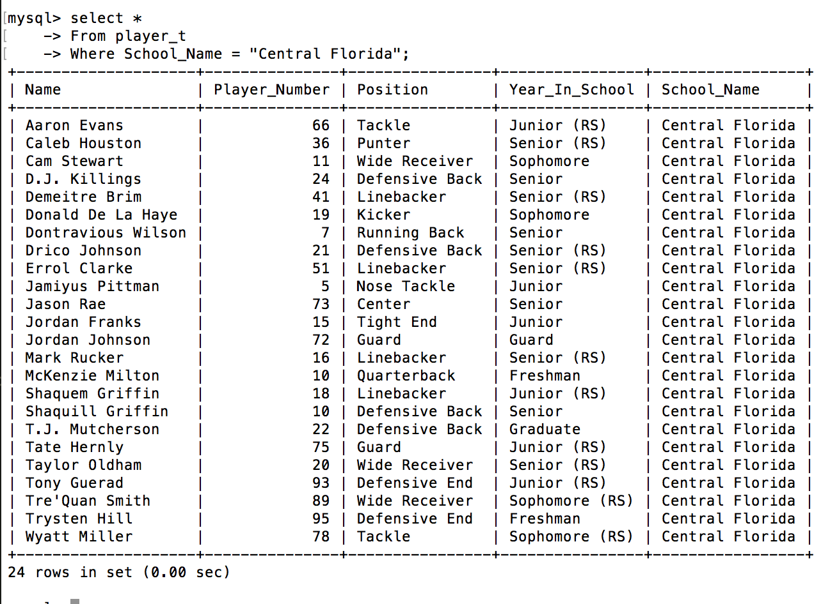

Slide 8
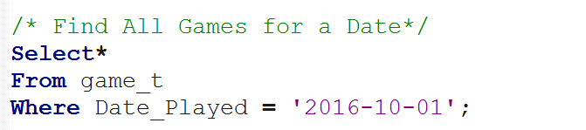

Slide 9
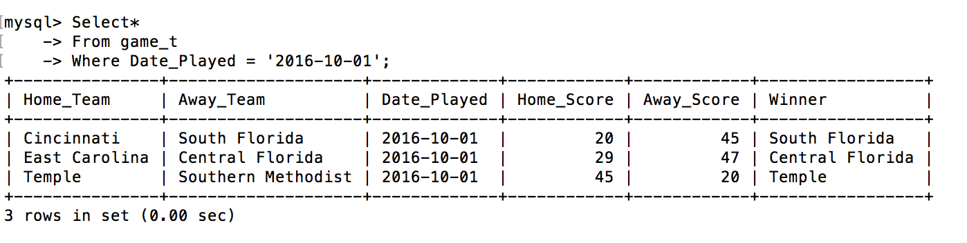

Slide 10
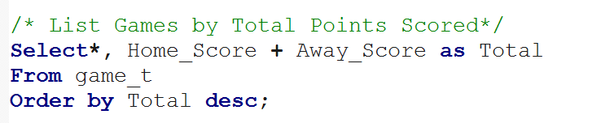

Slide 11
